Slide 1
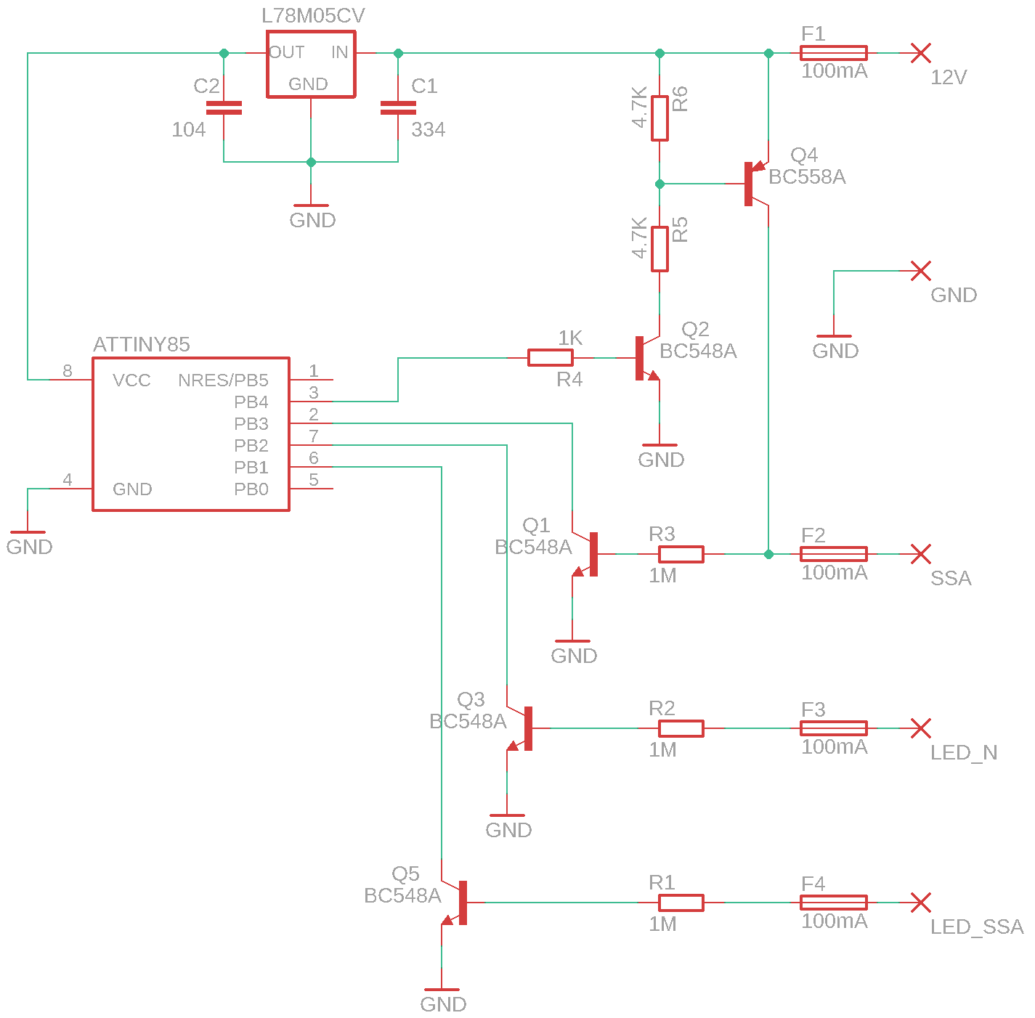
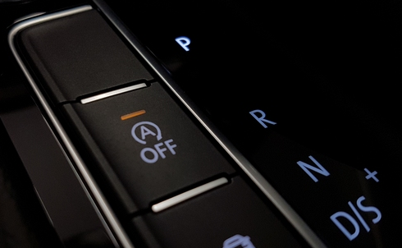
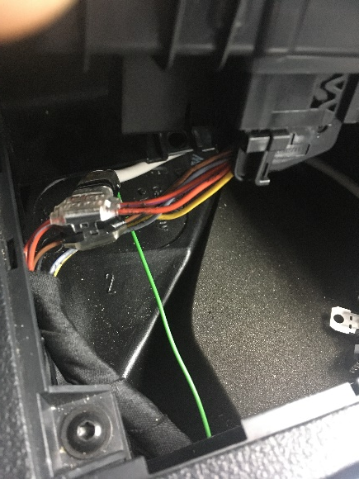
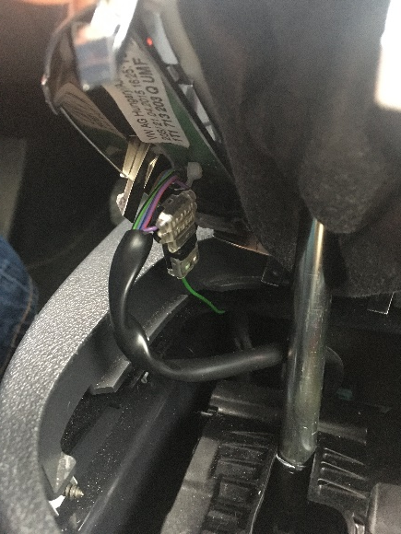
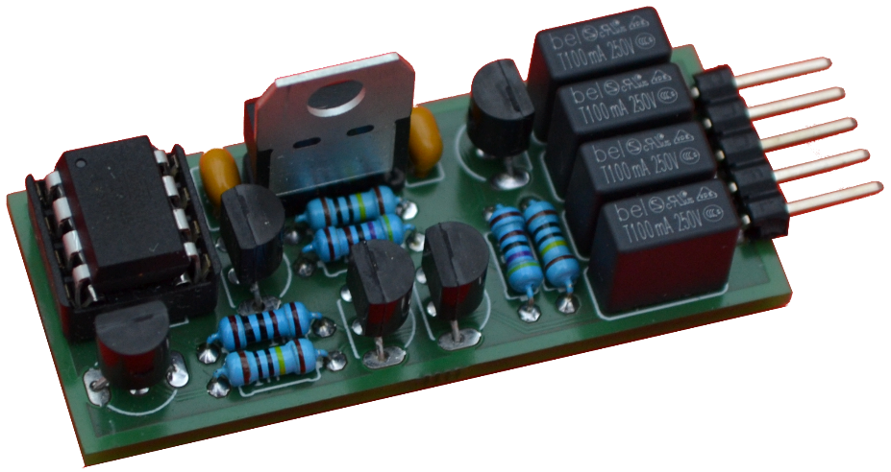
Improved Start-Stop-Automatic (SSA) for Automatic Gearshifts
Idea is to have equal functionality as for SSA with manual gearshift:
only in neutral gear SSA is active
in all other gear SSA is deactivated
The physical push-button is bypassed by electrical circuit (see yellow arrows) following a software logic based on information from two LEDs (SSA and Neutral).
Car-internal logic is not touched, only the push-button is duplicated.
Neutral-LED has a more complex signal (square-wave instead of pure high vs. low).
In case of rebuild for your own car:
Check cable-situation and signal-flow in your car!!
as passive input: high = button pressed
as passive input: low = button unpressed
as active output: high = SSA button virtually pressed by circuit
LED off = signal is high
but with 200Hz squarewave
LED on = signal is low
LED off = signal is high
LED on = signal is low
Connection to:
12V
GND
SSA
LED_SSA
Connection to:
LED_Neutral
12V
GND
SSA
LED_N
LED_SSA
PCB storage
LED_Neutral
equipped PCB used in car

